Slide 1
Introduction to Networks
By
Bwiino Keefa
Kbwiino@mubs.ac.ug
MUBS Jinja Campus

Slide 2
Table of Contents
Network Topolgies

Slide 3
Network Topologies
A topology refers to a network’s physical and logical layout.
A network’s physical topology refers to the actual layout of the computer cables and other network devices.
A network’s logical topology refers to the way in which the network appears to the devices that use it.
Some of the common topologies are the bus, ring, star, mesh, and wireless topologies

Slide 4
Bus Topology
A bus topology uses a trunk or backbone to connect all the computers on the network
Systems connect to this backbone using T connectors or taps (known as a vampire tap, if you must pierce the wire).
To avoid signal reflection, a physical bus topology requires that each end of the physical bus be terminated, with one end also being grounded.
Note that a hub or switch is not needed in this installation.
The most common implementation of a linear bus is the IEEE 802.3 Ethernet standard

Slide 5
Advantages and Disadvantages of a Bus Topology
Advantages | Disadvantages
Compared to other topologies, a bus is cheap and easy to implement | Network disruption might occur when computers are added or removed.
Requires less cable than other topologies. | Because all systems on the network connect to a single backbone, a break in the cable prevents all systems from accessing the network.
Does not use any specialized network equipment. | Difficult to troubleshoot.
NOTE: Loose or missing terminators from a bus network disrupt data transmissions.

Slide 6
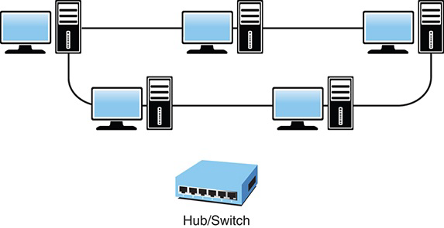
Ring Topology
The ring topology is a logical ring, meaning that the data travels in a circular fashion from one computer to another on the network
Note that a hub or switch is not needed in this installation.
In a true ring topology, if a single computer or section of cable fails, the signal is interrupted.
Network disruption can also occur when computers are added to or removed from the network

Slide 7
Configuration of a Ring Topology
Ring networks are most commonly wired in a star configuration.
In a token ring network, a Multistation access unit (MSAU) is equivalent to a hub or switch on an Ethernet network.
The MSAU performs the token circulation internally.
To create the complete ring, the ring-in (RI) port on each MSAU is connected to the ring-out (RO) port on another MSAU.
The last MSAU in the ring is then connected to the first to complete the ring

Slide 8
Advantages and Disadvantages of a Ring Topology
Advantages | Disadvantages
Cable faults are easily located, making troubleshooting easier. | Expansion to the network can cause network disruption.
Ring networks are moderately easy to install. | A single break in the cable can disrupt the entire network.

Slide 9
Star Topology
In the star topology, all computers and other network devices connect to a central device called a hub or switch.
Each connected device requires a single cable to be connected to the hub or switch, creating a point-to-point connection between the device and the hub or switch.
Using a separate cable to connect to the hub or switch allows the network to be expanded without disruption.
A break in any single cable does not cause the entire network to fail.

Slide 10
Advantages and Disadvantages of a Star Topology
Advantages | Disadvantages
Star networks are easily expanded without disruption to the network | Requires more cable than most of the other topologies.
Cable failure affects only a single user. | A central connecting device allows for a single point of failure.
Easy to troubleshoot and implement. | Requires additional networking equipment to create the network layout.
Note: The star topology is the easiest to expand in terms of the number of devices connected to the network.

Slide 11
Wired Mesh Topology
The wired mesh topology incorporates a unique network design in which each computer on the network connects to every other, creating a point-to-point connection between every device on the network.
The purpose of the mesh design is to provide a high level of redundancy.
If one network cable fails, the data always has an alternative path to get to its destination; each node can act as a relay.

Slide 12
Wired Mesh Topology
A variation on a true mesh topology is the hybrid mesh.
It creates a redundant point-to-point network connection between only specific network devices (such as the servers).
The hybrid mesh is most often seen in WAN implementations but can be used in any network.
Another way of describing the degree of mesh implementation is by labelling it as either partial or full.
If it is a true mesh network with connections between each device, it can be labelled full mesh, and if it is less than that—a hybrid of any sort—it is called a partial mesh network.

