Slide 1
IP Addressing & Subnetting
BY
BWIINO KEEFA
MIT(ICT-U), BCS(MUST), CCNA, Oracle

Slide 2
Introduction
A subnet is a logical subdivision of an IP network
The process of dividing a network into two or more networks is called subnetting
The main purpose of subnetting is to help relieve network congestion and improve network performance
Also, network security is derived from subnetting as the newtrok will have several segments

Slide 3
Important Terms in Subnetting
IP Address
An IP address is a unique string of (often randomized) numbers assigned to an individual computer or local network.
It's typically used as an identifier to collect, send, and share information from one location to the next.
IP addresses contain multiple numbers that are separated by dots/periods.
An example of an IP address may include:
192.158.1.282 or 182.111.5.222
IP addresses typically range from 0 to 255, meaning any digit used in an IP address is valid as long as it's over 0 and below 255.

Slide 4
Important Terms in Subnetting
IP Address
IP addresses often contain 2 parts:
Network ID: The network ID is a portion of an IP address used to designate a specific network or host. This section of the IP address is typically found towards the beginning of an IP address.
Host ID: The host ID is another portion of an IP address used to identify a specific IP/TCP network. A host ID is found after a network ID and can be used with class identifiers and to create default subnet masks as needed.

Slide 5
IP Addresses
With IP addresses, specific classes are used to designate the type of IP address visible to any network or individual.
Currently, there are 5 IP classes in total: Class A, Class B, Class C, Class D, and Class E.
The IP classes are defined as follows:
Class A: Large networks or entire ISP networks
Class B: Medium to large corporate organizations as well as more extensive networks or companies
Class C: Used for those on smaller networks or ISPs
Class D: Often used for those interested in multicasting
Class E: Typically reserved for experimental casting or use as well as for reserved addresses based on the ISP

Slide 6
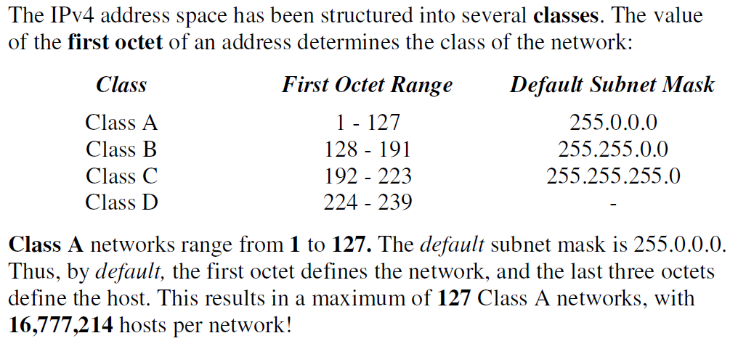
IP Address Classes

Slide 7
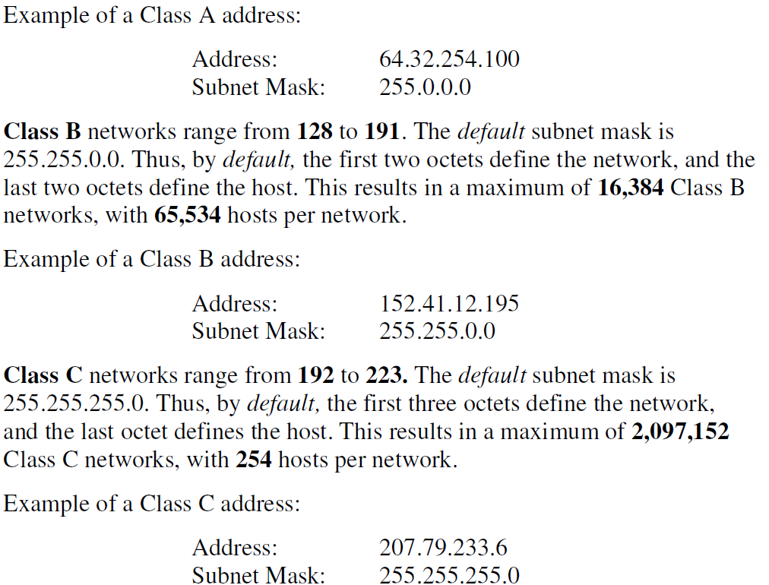
IP Address Classess

Slide 8
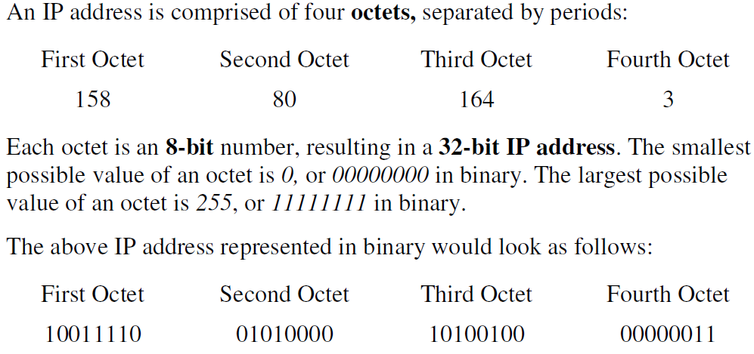
IP Addresses

Slide 9
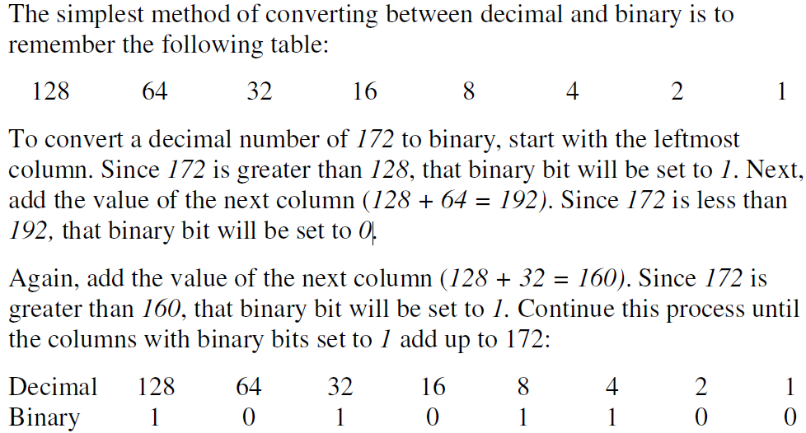
IP Addresses Conversion

Slide 10
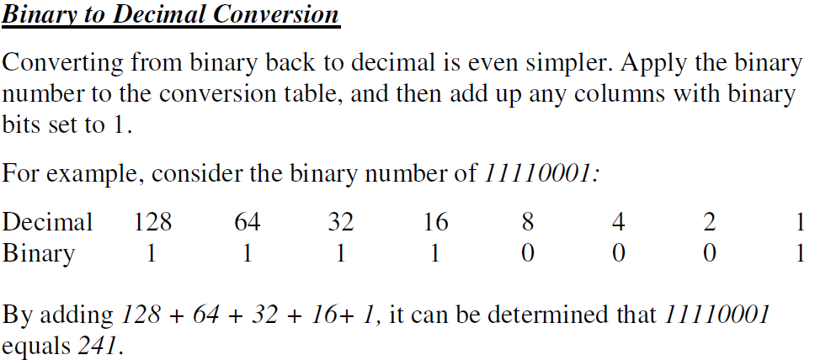
IP Addresses Conversion

Slide 11
Subnet Mask
A subnet mask is a 32-bit address that segregates an IP address into network bits that identify the network and host bits that identify the host device operating on that network
It encapsulates a range of IP addresses that a subnet can use, wherein the subnet refers to a smaller network within a more extensive network.
Technically, subnet masks are used internally within a network. Routing devices or switches rely on subnet masks to route data packets to suitable destinations.
Data packets that traverse over the internet or any network do not indicate the subnet mask but only reveal the IP address of the destination. However, the routers match this destination IP address to the data packet’s subnet mask to deliver the data packet to the right place.

Slide 12
Subnet Mask
A subnet mask is a 32-bit address that segregates an IP address into network bits that identify the network and host bits that identify the host device operating on that network
It encapsulates a range of IP addresses that a subnet can use, wherein the subnet refers to a smaller network within a more extensive network.
Technically, subnet masks are used internally within a network. Routing devices or switches rely on subnet masks to route data packets to suitable destinations.
Data packets that traverse over the internet or any network do not indicate the subnet mask but only reveal the IP address of the destination. However, the routers match this destination IP address to the data packet’s subnet mask to deliver the data packet to the right place.

Slide 13
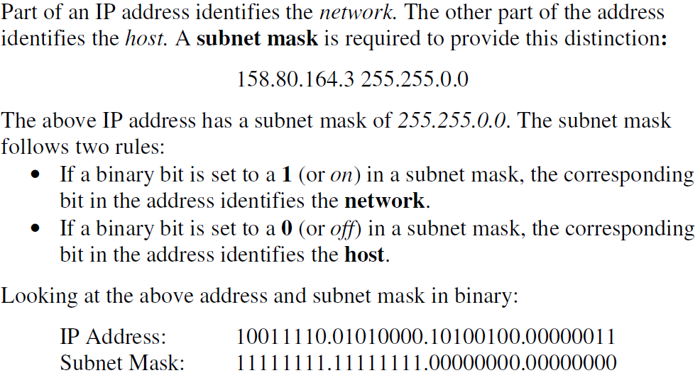
Subnet Mask

Slide 14
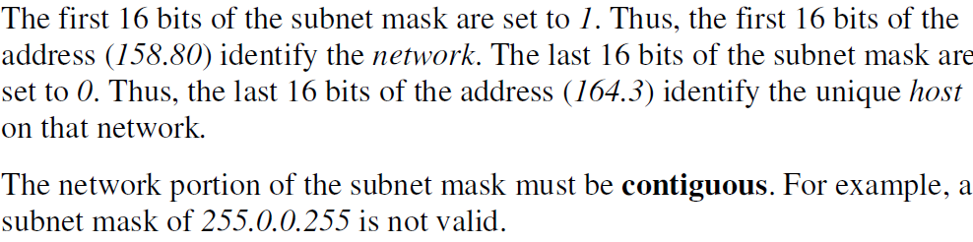
Subnet Mask

Slide 15
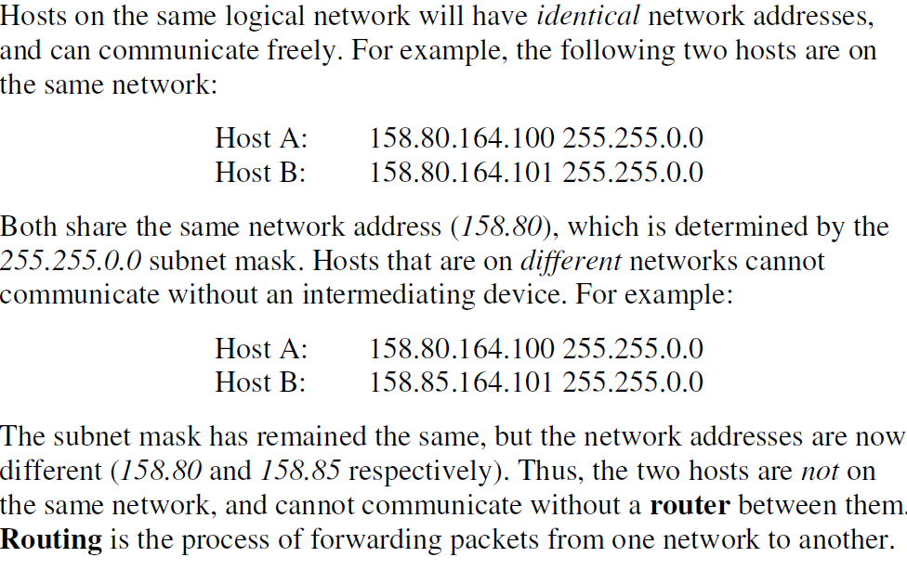
Subnet Mask

Slide 16
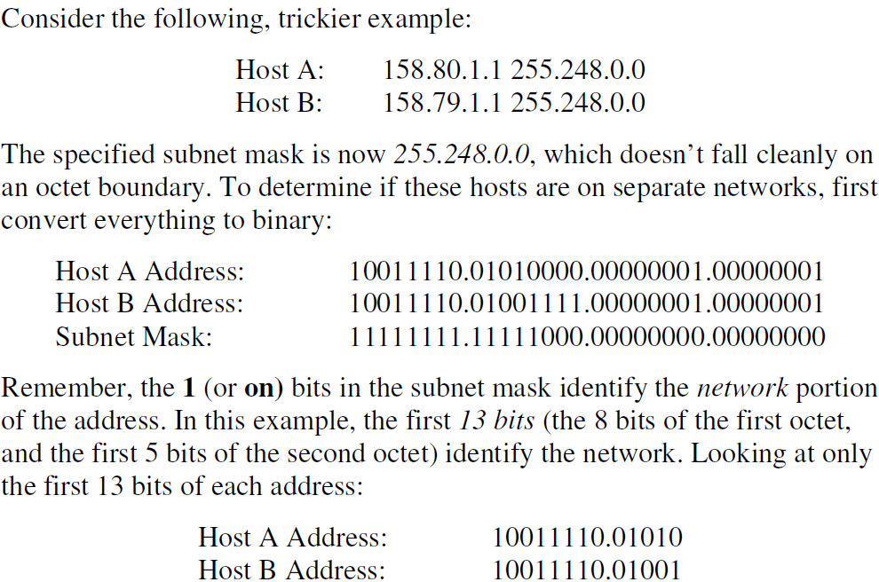
Subnet Mask

Slide 17
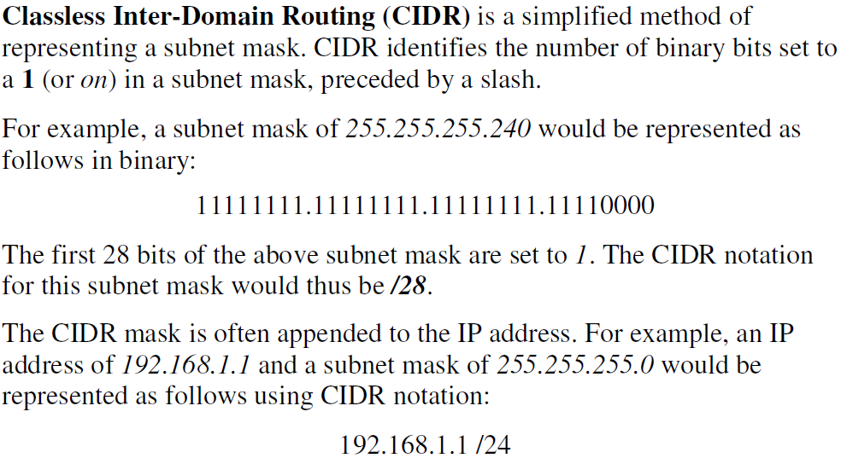
Classless Inter-Domain Routing (CIDR)

Slide 18
Subnetting Example
Question
Using the IP address 192.168.4.0 /24, create three separate networks or subnets for a secondary school. Designate one subnet for the administration, another for the staff room to be used by the teachers, and the third for students. For each subnet, list the Network ID, subnet mask, range of usable Host IDs, and Broadcast ID.

Slide 19
Subnetting Example
We start with the table below;
Subnet – The number of possible subnets or networks
Host- The number of host IDs or hosts per subnet or network
Subnet mask starting with the default subnet mask
Subnet | 1 | 2 | 4 | 8 | 16 | 32 | 64 | 128 | 256
Host | 256 | 128 | 64 | 32 | 16 | 8 | 4 | 2 | 1
Subnet Mask | /24 | /25 | /26 | /27 | /28 | /29 | /30 | /31 | /32

Slide 20
Subnetting Example
Using our table, we identify the required three networks in the top row, starting from the left, we realize it falls under 4 so we shall use that column
This means that we are dividing our network into 4 subnets, each new subnet will have 64 total Ids including network ID and broadcast ID, and the new subnet mask is /26
Subnet | 1 | 2 | 4 | 8 | 16 | 32 | 64 | 128 | 256
Host | 256 | 128 | 64 | 32 | 16 | 8 | 4 | 2 | 1
Subnet Mask | /24 | /25 | /26 | /27 | /28 | /29 | /30 | /31 | /32

Slide 21
Subnetting Example
Let us now list the Network Id, Subnet Mask, Host ID range, usable hosts and broadcast ID
You can now assign any three networks to the school. Note that the networks need a router to communicate to each other.
Network ID | Subnet Mask | Host ID Range | # of Usable Hosts | Broadcast ID
192.168.4.0 | /26 | 192.168.4.1-192.168.4.62 | 62 | 192.168.4.63
192.168.4.64 | /26 | 192.168.4.65-192.168.4.126 | 62 | 192.168.4.127
192.168.4.128 | /26 | 192.168.4.129-192.168.4.190 | 62 | 192.168.4.191
192.168.4.192 | /26 | 192.168.4.193-192.168.4.254 | 62 | 192.168.1.255

Slide 22
Subnetting Example
Question
Using the IP address 192.168.254.0, create ten separate networks or subnets for the organization. For each subnet, list the Network ID, subnet mask, range of usable Host IDs, and Broadcast ID.
Solution
The default subnet maks is 255.255.255.0 since this is a class C. Our IP address can be written as
192.168.254.0 /24

Slide 23
Subnetting Example
We now use our subnetting table below;
Subnet – The number of possible subnets or networks
Host- The number of host IDs or hosts per subnet or network
Subnet mask starting with the default subnet mask
Subnet | 1 | 2 | 4 | 8 | 16 | 32 | 64 | 128 | 256
Host | 256 | 128 | 64 | 32 | 16 | 8 | 4 | 2 | 1
Subnet Mask | /24 | /25 | /26 | /27 | /28 | /29 | /30 | /31 | /32

Slide 24
Subnetting Example
Using our table, we identify the required 10 networks in the top row, starting from the left, we realize it falls under 16 so we shall use that column
This means that we are dividing our network into 16 subnets, each new subnet will have 16 total Ids including network ID and broadcast ID, and the new subnet mask is /28
Subnet | 1 | 2 | 4 | 8 | 16 | 32 | 64 | 128 | 256
Host | 256 | 128 | 64 | 32 | 16 | 8 | 4 | 2 | 1
Subnet Mask | /24 | /25 | /26 | /27 | /28 | /29 | /30 | /31 | /32

Slide 25
Network ID | Subnet Mask | Host ID Range | # of Usable Hosts | Broadcast ID
192.168.254.0 | /28 | 192.168.254.1-192.168.254.14 | 14 | 192.168.254.15
192.168.254.16 | /28 | 192.168.254.17-192.168.254.30 | 14 | 192.168.254.31
192.168.254.32 | /28 | 192.168.254.33-192.168.254.46 | 14 | 192.168.254.47
192.168.254.48 | /28 | 192.168.254.49-192.168.254.62 | 14 | 192.168.254.63
192.168.254.64 | /28 | 192.168.254.65-192.168.254.78 | 14 | 192.168.254.79
192.168.254.80 | /28 | 192.168.254.81-192.168.254.94 | 14 | 192.168.254.95
192.168.254.96 | /28 | 192.168.254.97-192.168.254.110 | 14 | 192.168.254.111
192.168.254.112 | /28 | 192.168.254.111-192.168.254.126 | 14 | 192.168.254.127
192.168.254.128 | /28 | 192.168.254.129-192.168.254.142 | 14 | 192.168.254.143
192.168.254.144 | /28 | 192.168.254.145-192.168.254.158 | 14 | 192.168.254.159
192.168.254.160 | /28 | 192.168.254.161-192.168.254.174 | 14 | 192.168.254.175
192.168.254.176 | /28 | 192.168.254.177-192.168.254.190 | 14 | 192.168.254.191
192.168.254.192 | /28 | 192.168.254.193-192.168.254.206 | 14 | 192.168.254.207
192.168.254.208 | /28 | 192.168.254.209-192.168.254.222 | 14 | 192.168.254.223
192.168.254.224 | /28 | 192.168.254.225-192.168.254.238 | 14 | 192.168.254.239
192.168.254.240 | /28 | 192.168.254.241-192.168.254.254 | 14 | 192.168.254.255
You can now assign any three networks to the school. Note that the networks need a router to communicate to each other.

Slide 26
Therefore we shall use any 10 of the 16 networks in the table above.

Slide 27
Subnetting a Subnet
Given a subnet network address and a subnet mask, you can create more smaller networks from this, this is called subnetting a subnet.
Example
You are given a single network ID: 125.23.200.64/26, you are asked to set up 3 separate subnets for three different departments.
List each network ID, subnet mask, Host ID range, the number of usable host IDs, and the Broadcast ID
Why is the address 125.23..200.64 /26 a subnet ID? This is because of the subnet mask

Slide 28
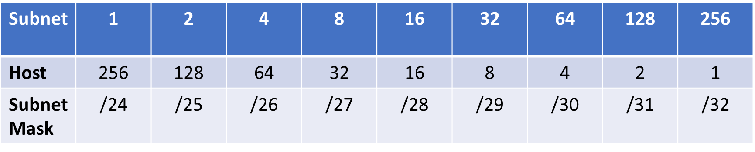
Subnetting a Subnet
Why is the address a subnet ID?
The subnet mask /26 suggests that the address we have been given is one of the four subnets. According to the question, we are required to divide our network into 3 networks but we know from our subnetting table that this is impossible we can get 4 subnets, 8, or 16, or 32 subnets, and so on.

Slide 29
Subnetting a Subnet
In this example, 4 subnets will be enough for us to create the required 3 subnets.
So we multiply 4 by 4, we get 16. if we wanted like 6 subnets we would multiply 4 by 8, we get 32.
In the next step, we locate the number 16 in the first row of our subnet table. This gives us 16 host IDs and the new subnet mask is /28
The final step is to make the table

Slide 30
Subnetting a Subnet
# | Network ID | Subnet Mask | Host ID Range | # of Usable Hosts | Broadcast ID
1 | 125.23.200.64 | /28 | 125.23.200.65 – 125.23.200.78 | 14 | 125.23.200.79
2 | 125.23.200.80 | /28 | 125.23.200.81 – 125.23.200.94 | 14 | 125.23.200.95
3 | 125.23.200.96 | /28 | 125.23.200.97 – 125.23.200.110 | 14 | 125.23.200.111
4 | 125.23.200.112 | /28 | 125.23.200.113 – 125.23.200.126 | 14 | 125.23.200.127

Slide 31
Practice Questions
Suppose you have a class B ID 172.16.0.0 /16, you are required to create 4 new subnets to accommodate four Departments of the faculty of computing.
What is the new subnet mask?
How many usable host IDs for each new subnet
List each network ID, with its usable host ID range and broadcast ID

